Slide 1


Slide 2
Digital Manufacturing - Obfuscating the Design with Security Features
Nathan DeVol, Patrick Jung, Lance Lu
Georgia Institute of Technology

Slide 3
Solution Approach
Open .STL file in Autodesk Fusion 360
Look for anomalies between faces -- weird spots, shapes, patterns in triangle
Identified several faces of interest where the number of dots could be determined (2 dots, 3 dots, 4 dots, 5 dots, 6 dots)
Open .STL file in text editor. Looked for non-STL lines (ex: comments)
Comment identified a group of triangles as Face 1
Used normal vector and coordinate system in Autodesk to determine which face was referenced in comment
Connect faces, dots, to the letter template using Fusion model for reference

Slide 4
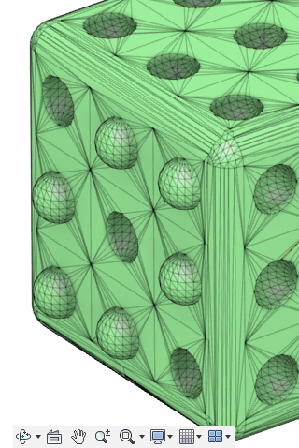
.STL Viewing in Fusion 360
First anomaly noticed was this on plane (0,0,-1)
3 dots are sunken, and the rest are raised
This seemed to be associated with the provided clue for Face B
“Mountaintops inspire leaders, but valleys mature them”
Using the clue, this was determined to be Face B, with 3 dots

Slide 5
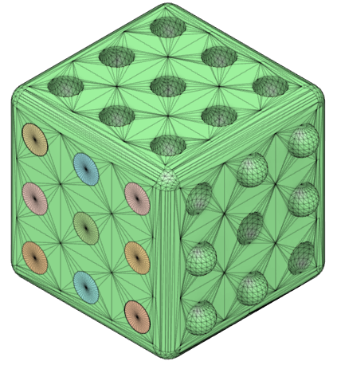
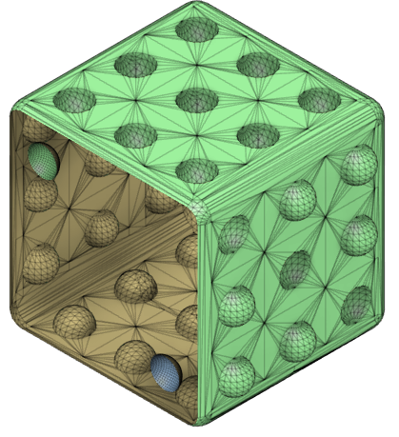
.STL Viewing in Fusion 360
Face (1,0,0) appears to be flat which stands out
When viewed from behind, 2 dots appear
At this point, it was unable to determine which letter face the 2 dots was

Slide 6
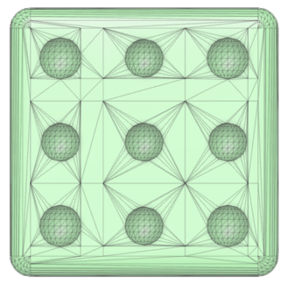
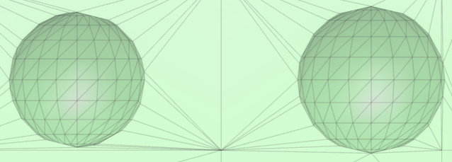
.STL Viewing in Fusion 360
Face (0,0,1) stands out because its triangles create an asymmetrical pattern, unlike the other faces
Upon closer examination, it was seen that 5 of the spheres were smaller than the other 4.
At this point, it was unable to determine whether this corresponded to 4 or 5
Face 4 seems the most likely as it fits the typical die pattern
This is Face D, as it is opposite of Face B (identified earlier)

Slide 7
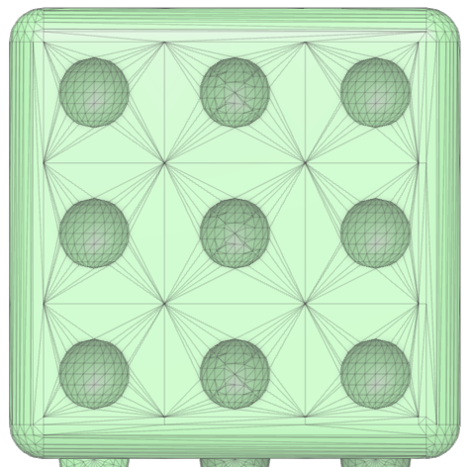

.STL Viewing in Fusion 360
Face (0,1,0) stands out because some of its spheres have an “X” pattern inside them
Using the “X” patterns to cross out spherical indents, leaves us with 6 dots
This is Face C, according to the given diagram
The orientation of the 6 dots also gives a notion of orientation of the die based on the given diagram
Further confirmation from the clue (Railroad signs typically have an “X” pattern)

Slide 8
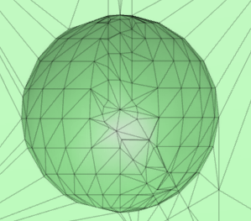
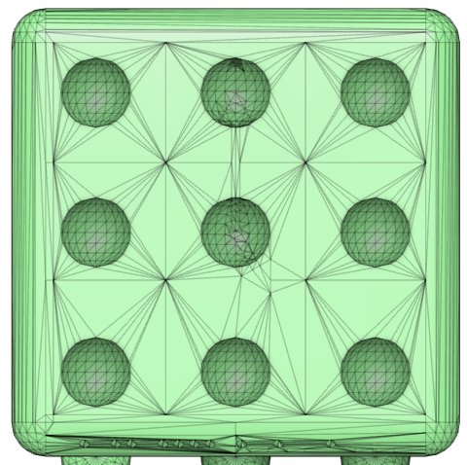

.STL Viewing in Fusion 360
Face (0,-1,0) stands out because its triangles form an asymmetrical pattern
The center sphere seems to be source of the anomaly
The pattern forms a clock face that show 5 o’clock. This was decided to be the 5-Dot face

Slide 9
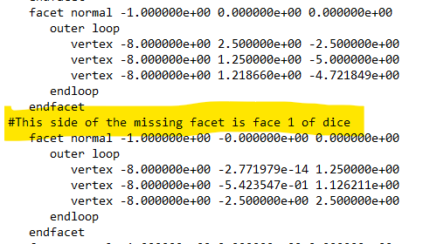
Text Editor Viewing of .STL
Notepad was used to open the .STL file
Searching for oddities in the file, a comment was found
This identified the face with plane coordinates (-1,0,0) as Face 1 (1 dot)
This face is directly opposite of Face 2

Slide 10
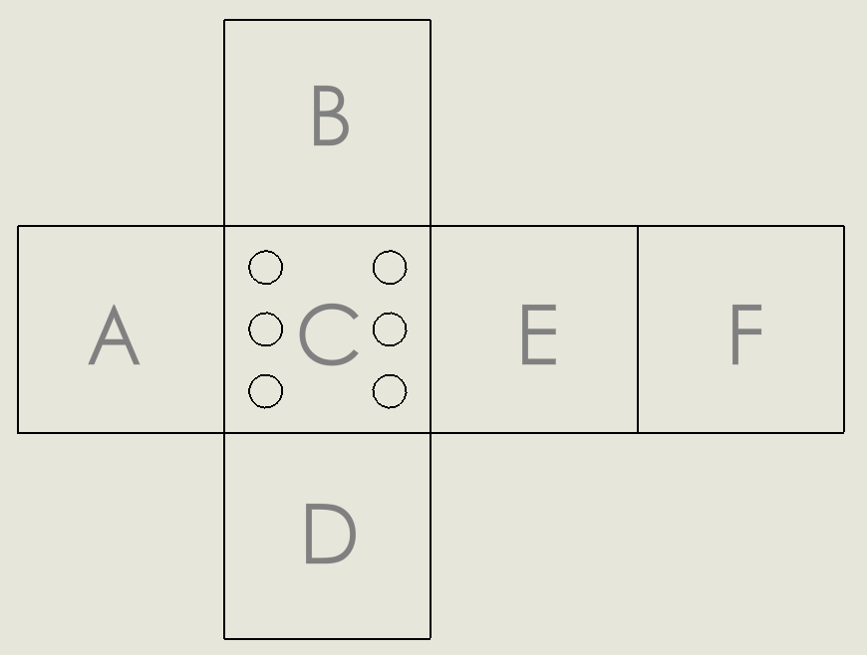
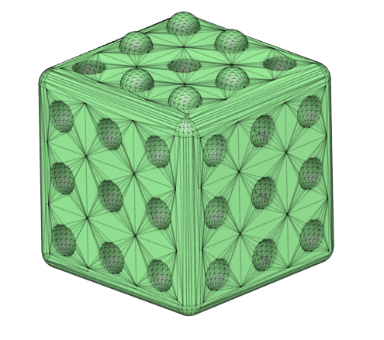
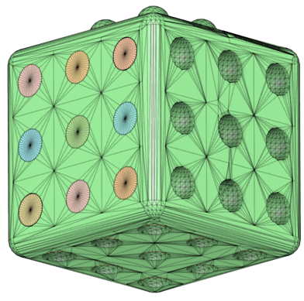
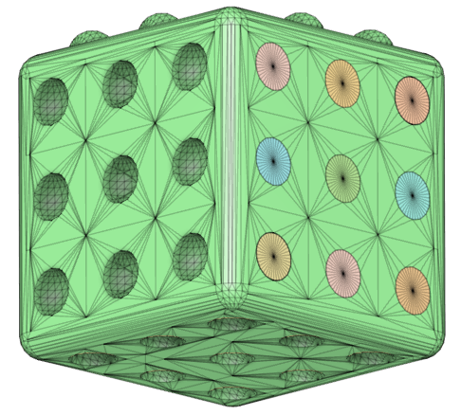
Filling in the diagram
3
3
2
5
1
6
1
2
5
4
4
6
2
The diagram was filled in with help of Fusion 360, and then unfolding the layout
All faces had been identified in the model, and Face B and C were used to orient the die
4

Slide 11
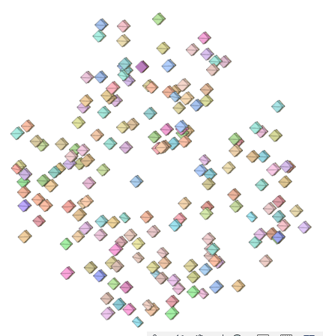
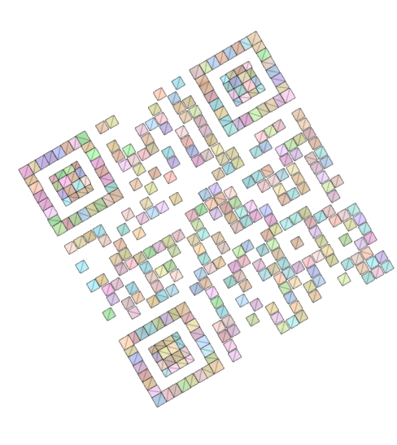
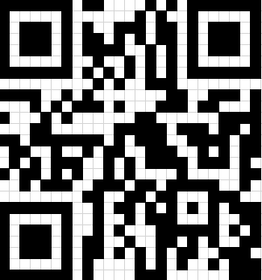
QR Code identification
To see more clearly, the die faces were hidden to reveal the embedded QR code
Panning and orbiting around the model until the correct view was found
Once the correct view was found, a binary image was made using Excel
When the QR code was scanned, it took us to a protected .PDF file

Slide 12
PDF-File Password Cracking
Circular patterns were noticed on one rounded edge of the die
Closer examination also showed bars
Morse code translation
-- = M . = E -.-. = C …. = H .. = I . = E
Password = mechie

Slide 13
